Slide 1

SignConnect: A Real-Time Bidirectional Communication Assistant for Online Meetings
MINOR PROJECT
Members:
Mentor:
Akshara Satheesh Nair (RA2311042010024)
Shubiksha K (RA2311042010018)
V Pranav Krishna (RA2311042010046)
Dr.P.Varun

Slide 2
Problem statement:
Communication barriers for hearing- or speech-impaired individuals in online meetings.
Current tools provide either speech-to-text or sign-to-text, but not a unified system.
Need for a real-time, bidirectional, accessible solution.

Slide 3
Project Objective:
Transcribe speech from meetings in real time.
Detect sign language gestures from users and convert them to text & speech.
Provide a simple, user-friendly interface for accessible online communication to create a unified interface for inclusive, real-time interaction.

Slide 4
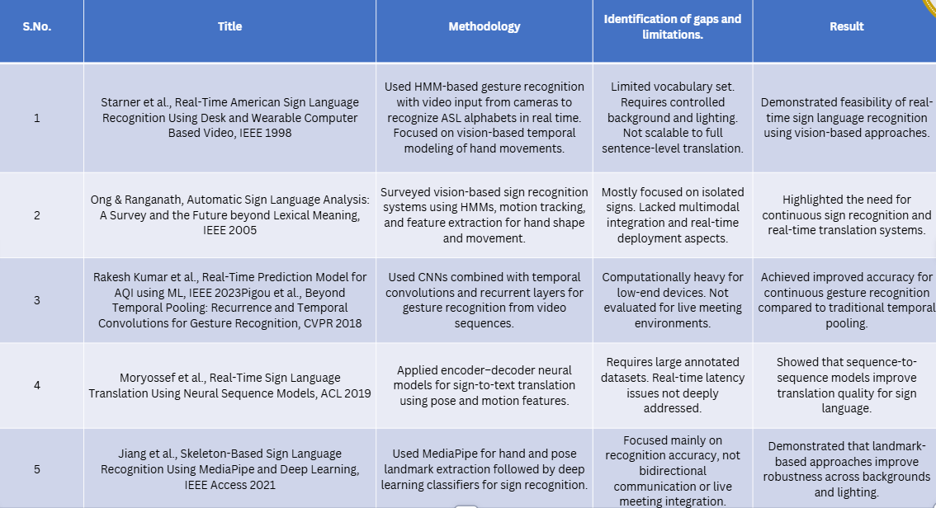
Literature Review

Slide 5
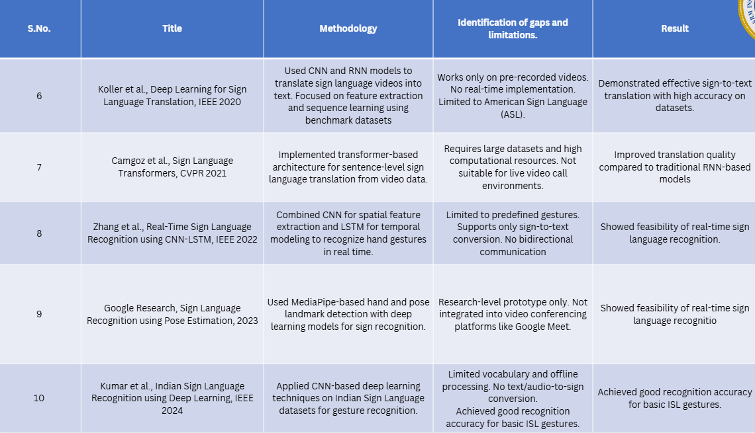
Literature Review

Slide 6
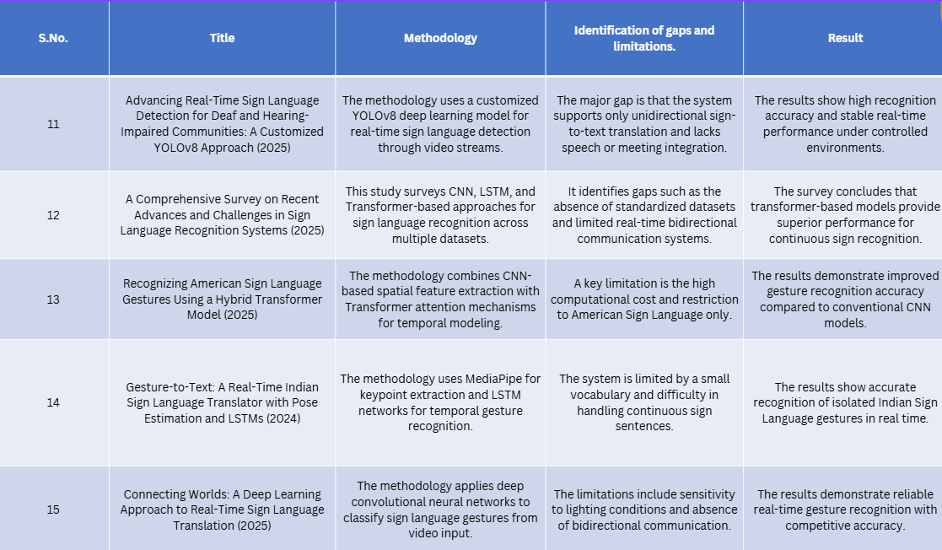
Literature Review

Slide 7
System Overview (High-Level Architecture):
🔹 1. Input Layer
The system takes two types of inputs:
Meeting audio from online platforms such as Zoom or Google Meet
Webcam video capturing the signer’s hand gestures
These inputs are processed simultaneously, ensuring real-time interaction.
🔹 2. Audio Processing Pipeline (Left Side)
Meeting speech is captured and passed to Whisper (Speech-to-Text)
Whisper converts spoken audio into live textual captions
These captions are displayed on the user interface, supporting deaf and hard-of-hearing users
This pipeline enables speech → text communication.

Slide 8
System Overview (High-Level Architecture):
🔹 3. Video Processing Pipeline (Right Side)
Webcam input is processed using MediaPipe, which extracts precise hand landmarks
The landmarks are normalized and sequenced to form temporal data
A Bi-LSTM model analyzes these sequences to learn temporal dependencies in gestures
The extracted temporal features are classified using an SVM, producing the recognized sign text
This pipeline enables sign → text conversion.
🔹 4. Output Module
The recognized sign text is:
Displayed as text on the UI

Slide 9
System Overview (High-Level Architecture):
Converted into speech using a Text-to-Speech (TTS) engine
The generated audio is played for hearing participants
This completes the sign → speech direction.
🔹 5. Backend & Integration
A Flask backend manages streaming, model inference, and synchronization
The web UI runs as an overlay, allowing SignConnect to work alongside Zoom, Meet, or Teams without modifying them.

Slide 10
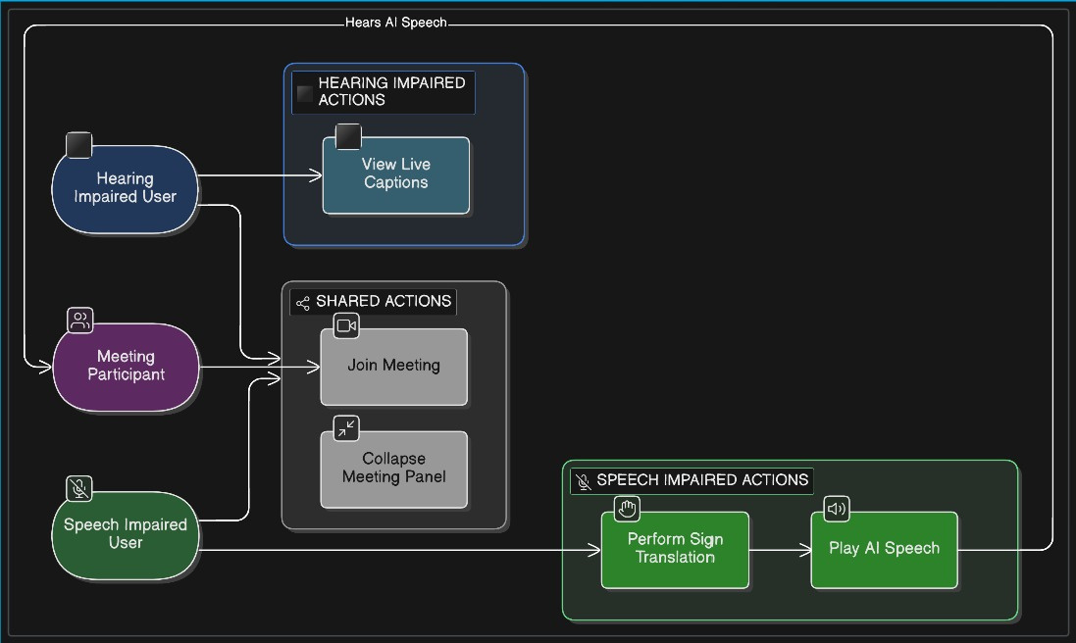
Use Case Diagram

Slide 11
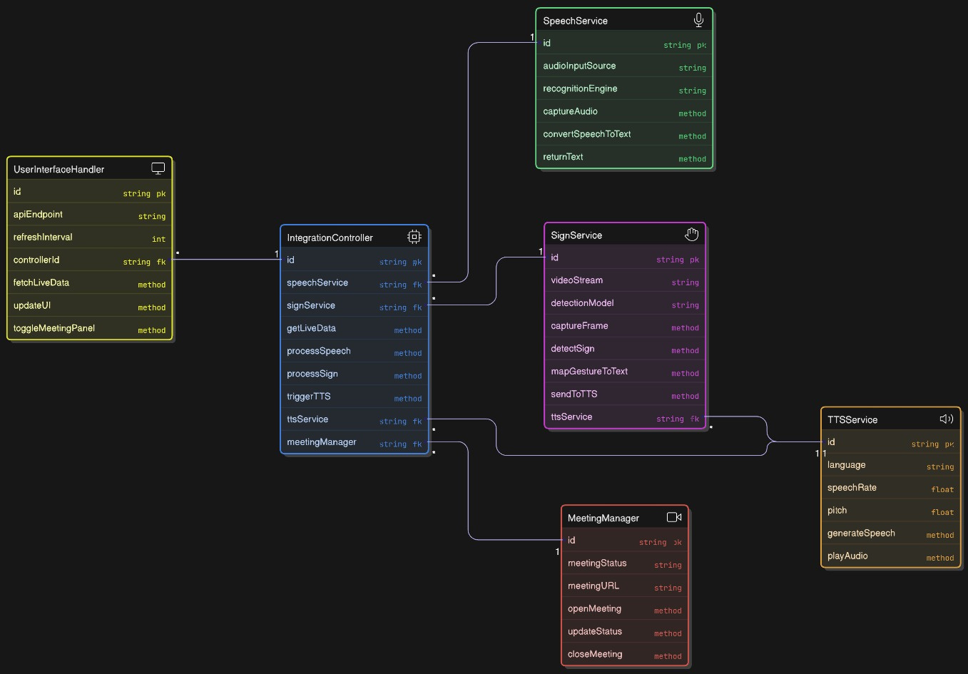
ER Diagram

Slide 12
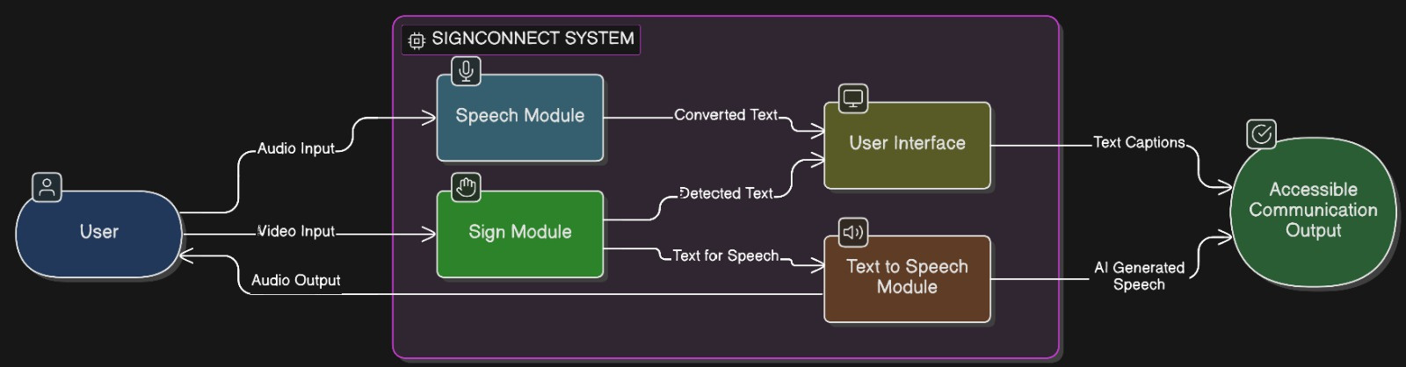
Data Flow Diagram

Slide 13
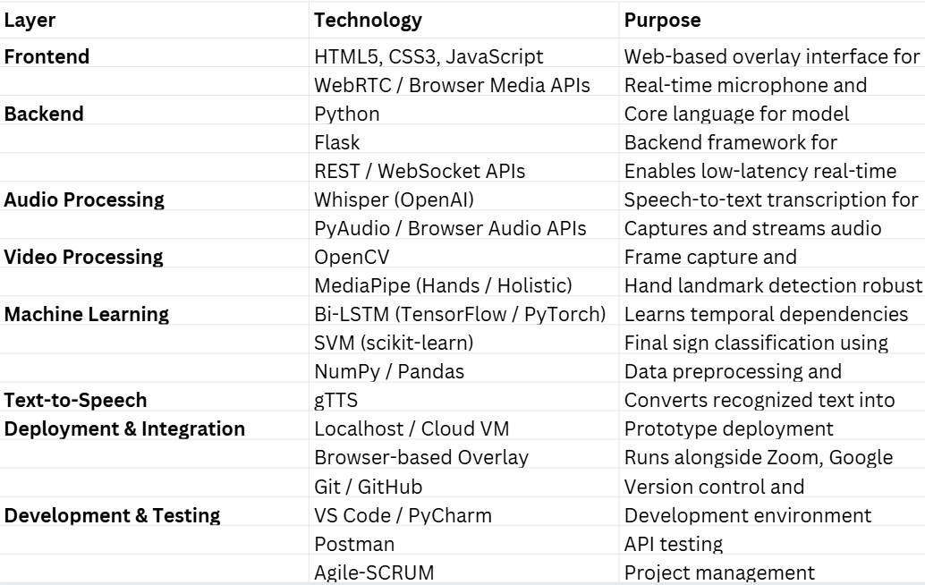
Technology Stack

Slide 14
Methodology
Data Acquisition:
Live audio (16 kHz, mono) and webcam video (25–30 fps) are captured from online meetings.
Audio is segmented; video frames are resized.
Speech-to-Text Processing:
Captured audio is converted to a log-Mel spectrogram.
Transcribed into live captions using the Whisper transformer model for hearing-impaired users.
Sign Language Recognition Pipeline:
Video frames undergo:
Landmark Extraction: MediaPipe extracts 3D hand joint coordinates for reduced complexity and robustness.
Data Normalization: Coordinates are normalized relative to the wrist and scaled for invariance to camera/hand position/size.
Temporal Sequencing: Normalized vectors are grouped into fixed-length sequences using a sliding window to model gesture motion.

Slide 15
Methodology
4.Temporal Feature Learning using Bi-LSTM
Landmark sequences are processed by a Bidirectional Long Short-Term Memory (Bi-LSTM) network.
The concatenated hidden states from forward and backward LSTMs create a comprehensive temporal feature representation.
5.Gesture Classification using SVM
Bi-LSTM features are classified by a Support Vector Machine (SVM).
The SVM learns a maximum-margin boundary, combining Bi-LSTM's sequence modeling with SVM's classification robustness.
6.Text-to-Speech Conversion
Recognized sign labels are mapped to words.
These words are converted into real-time audible speech for hearing participants using gTTS.

Slide 16
Methodology
7. Backend Coordination and Integration
The backend, built on Flask, oversees data streaming, model inference, and the synchronization of audio and video pipelines. It utilizes RESTful and streaming APIs to ensure low-latency communication.
8. Frontend Interface
The frontend features a browser-based web overlay that provides live captions, recognized sign text, and controls for synthesized speech. It operates seamlessly alongside platforms like Zoom, Meet, and Teams.
9. Performance Evaluation
The system's performance is assessed based on several factors: latency, accuracy (in both speech and sign recognition), throughput, and usability during real-time meeting scenarios.

Slide 17
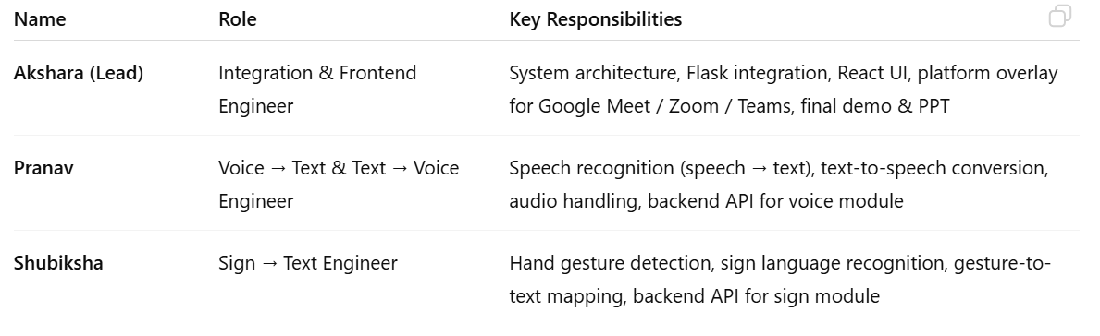
Implementation Plan

Slide 18
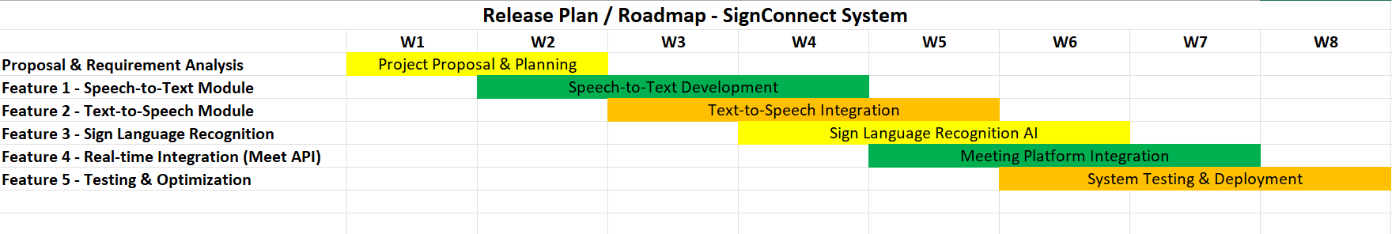

Slide 19
EXPECTED OUTPUT
A simple, user-friendly web interface where:
Speech is transcribed in real time.
Signs are recognized and converted into both text and voice.

Slide 20
Advantages / Impact
Enables inclusive participation in online meetings for deaf, hard-of-hearing, and mute individuals.
Runs on low-cost devices and uses fully open-source tools, making it affordable and scalable.
Promotes accessibility and digital equality by bridging communication gaps.
Applicable across domains — schools, workplaces, virtual classrooms, clinics, and public services.

Slide 21
Future Scope
Multi-language translation for both speech and sign outputs.
Browser extension for real-time communication, enabling use on Zoom, Meet, Teams, etc.
Emotion detection from voice or sign gestures to improve contextual understanding.
Support for complex sign sequences, enabling full phrases and conversational flow.

Slide 22
THANK YOU

